Slide 1
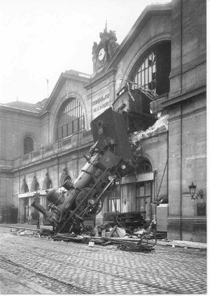
Chapter 3
Experimental Error
The derailment on October 22, 1895 of the Granville-Paris Express that overran the buffer stop. The engine careened across almost 100 feet (30 meters) of the station concourse, crashed through a two-foot thick wall, shot across a terrace and sailed out of the station, plummeting onto the Place de Rennes 30 feet (10 meters) below where it stood on its nose. While all of the passengers on board the train survived, one woman on the street below was killed by the falling train.

Slide 2
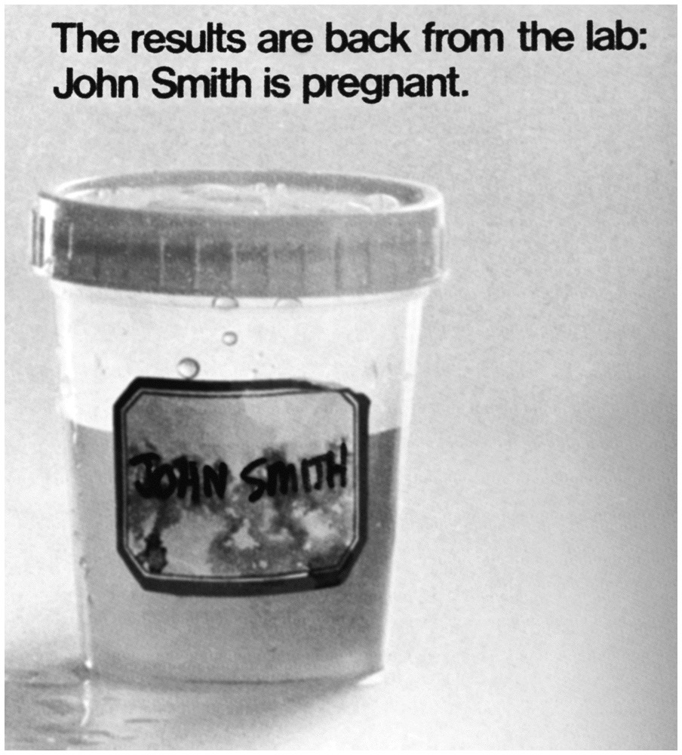

Slide 3
Significant Figures
”The number of significant figures is the minimum number of digits needed to write a given value in scientific notation without loss of accuracy.“
9.25 x 10⁴ 3 signif. figs
9.250 x 10⁴ 4 signif. figs
9.2500 x 10⁴ 5 signif. figs
most significant figure - the left-hand most digit, the digit which is known most exactly
least significant figure - the right-hand most digit, the digit which is known most exactly

Slide 4
Counting Significant Figures
Rules for determining which digits are significant:
All non-zero numbers are significant.
Zeros between non-zero numbers are significant.
Zeros to the right of the non-zero number and to the right of the decimal point are significant.
4. Zeros before non-zero numbers are not significant.

Slide 5
Significant Figures
When reading the scale of any apparatus, you should interpolate between the markings. It is usually possible to estimate to the nearest tenth of the distance between two marks.
0. 55 cm?
0. 56 cm?
2 signif. figs
0
1 cm
0. 55 cm implies an error of at least 0.55 ± 0.01 cm

Slide 6
Significant Figures
In experimental data, the first uncertain figure is the last significant figure.

Slide 7
Significant Figures in Arithmetic
Exact numbers
conversion factors, significant figure rules do not apply

Slide 8
Significant Figures in Arithmetic
Addition and Subtraction
For addition and subtraction, the number of significant figures is determined by the piece of data with the fewest number of decimal places.
4.371
+ 302.5
306.8

Slide 9
Significant Figures in Arithmetic
Multiplication and Division
For multiplication and division, the number of significant figures used in the answer is the number in the value with the fewest significant figures.
$$\frac{2075∙14}{144}=2.0 x {10}^{2}$$

Slide 10
Significant Figures in Arithmetic
Logarithms and Antilogarithms
logarithm of n:
n = 10ª log n = a
n is the antilogarithm of a
log (339)= 2.530 log(3.39 x 10⁻⁵ )=-4.470
2 character -4 character
.530 mantissa .470 mantissa

Slide 11
Significant Figures in Arithmetic
Logarithms and Antilogarithms
The number of significant figures in the mantissa of the logarithm of the number should equal the number of significant figures in the number.
The character in the logarithm corresponds to the exponent of the number written in scientific notation.

Slide 12
Significant Figures in Arithmetic
Logarithms and Antilogarithms
The number of significant figures in the antilogarithm should equal the number of digits in the mantissa.
antilog (-3.42) = 10^{-3.42} = 3.8 X 10⁻⁴
2 s.f. 2 s.f. 2 s.f.

Slide 13
Significant Figures in Arithmetic
n = 1 x 10² (1 s.f.), log(2.0) (1s.f)
n = 5 x 10² (1 s.f.), log(2.7) (1s.f)
n = 1 x 10³ (1 s.f.), log(3.0) (1s.f)

Slide 14
Types of Error
Systematic Error (determinate error)
The key feature of systematic error is that, with care and cleverness, you can detect and correct it.
Examples of Determinate Errors
instrument error
method errors
personal errors

Slide 15
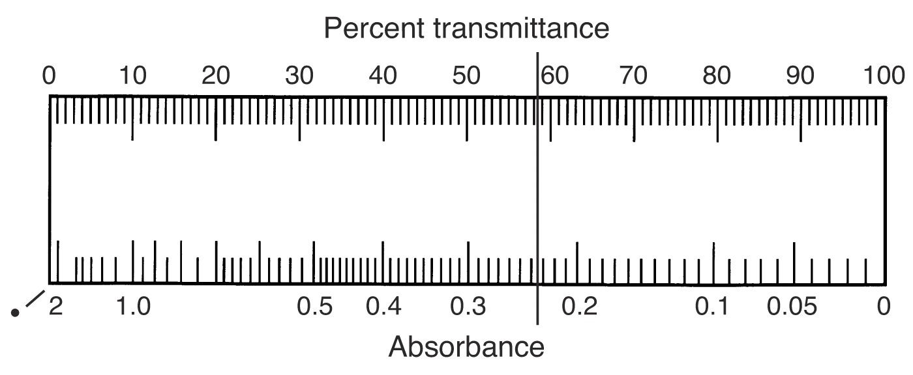
Analog Spectrometer
% T = 58.5 ?
= 58.3 ?
A = 0.233 ?
= 0.234 ?
0.003
$$A=−log⁡(T)$$
0.001
% T = 18.5 ?
= 18.3 ?
A = 0.733 ?
= 0.738 ?
0.005
0.003
$$A=−log⁡(T)$$

Slide 16
Types of Error
Effects of Determinate Errors
constant errors
Detection of Determinate Instrument and Personal Errors

Slide 17
Types of Error
Detection of Determinate Method Errors
analysis of standard samples (SRS)
independent analysis
blank determinations
variation in sample size

Slide 18
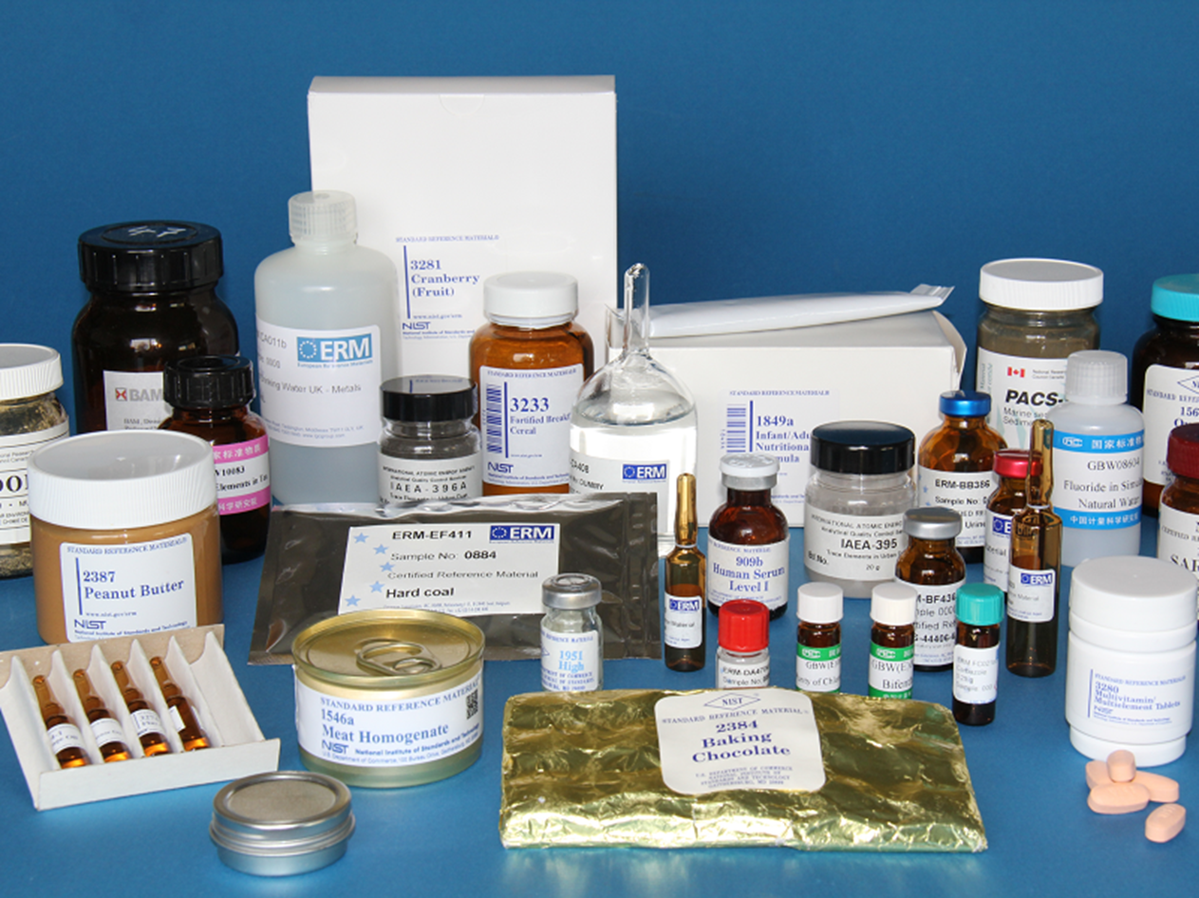
(SRS) Standard Reference Samples

Slide 19
Types of Error
Detection of Determinate Method Errors
analysis of standard samples (SRS)
independent analysis
blank determinations
variation in sample size

Slide 20
Types of Error
Random Error (indeterminate error)
It is always present, cannot be corrected, and is the ultimate limitation on the determination of a quantity.
Types of Random Errors
- reading a scale on an instrument caused by the finite thickness of the lines on the scale
- electrical noise

Slide 21
Random error in a buret reading is about ± 0.02 mL
If Initial reading is 45.06 ± 0.02 mL
Final reading is 12.67± 0.02 mL
What is the precision (±) of the delivered volume?
The errors in the IR and FR are absolute uncertainties
The relative uncertainty is 0.02mL/45.06mL *100 = 0.04%
The larger measurement, the smaller the relative uncertainty

Slide 22
Can you hit the bull's-eye?
Three shooters with three arrows each to shoot.
How do they compare?
Both accurate and precise
Precise but not accurate
Systematic
(determinate) error
Neither accurate nor precise
Random
(indeterminate) error
Can you define accuracy and precision?

Slide 23
Precision and Accuracy
Precision
Reproducibility
Accuracy (AKA bias)
closeness to accepted value
An ideal procedure provides both precision and accuracy.
Does that mean you can be precisely wrong? WHAT??

Slide 24
Absolute Uncertainty (Error)
accuracy
bias
systematic error
same units as measurement
absolute uncertainty = (your value - true value)
= (E.V.– T.V.)

Slide 25
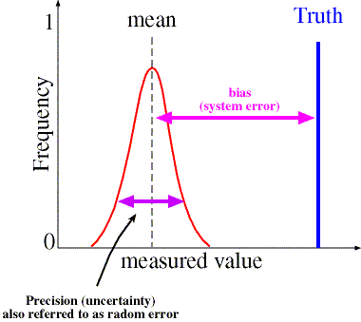
Bias is the offset between the population mean and the true value of the property measured.
population mean
true
value
bias
$$γ_{x}=μ_{x}\text{−} ξ$$

Slide 29
…and NOW
The Real Rule of Significant Figures
The number of figures used to express a calculated result should be consistent with the uncertainty in that result.
Or – The answer should have the same number of decimal places as the ERROR..

Slide 30
Relative Uncertainty (Error)
no units (ratio of numbers with same units)
relative uncertainty $=\frac{\text{absolute} \text{uncertainty} }{\text{true} \text{value} }$
% relative uncertainty $=\frac{\text{absolute} \text{uncertainty} }{\text{true} \text{value} }$·100

Slide 31
Propagation of Error
When possible uncertainty is expressed as a standard deviation or as a confidence interval - more on this later!
applies only to random error
WHY???

Slide 32
Propagation of Error
Addition and Subtraction
uncertainty in addition and subtraction
$e=\sqrt{e_{1}^{2}+e_{2}^{2}}$
$$e=\sqrt{e_{1}^{2}+e_{2}^{2}+e_{3}^{2}}$$
Example
In a titration, the initial reading on the burette is 28.51 mL and the ﬁnal reading is 35.67 mL, both with an uncertainty of ±0.02 mL. What is the final volume of titrant used including the error?
Final volume - initial volume = volume delivered
35.67 mL – 28.51 mL = 7.16 ± ? mL
$e=\sqrt{{0.02}^{2}+{0.02}^{2}}$ = 0.028…..mL
Applying the real rule of sig. figs.
The final volume (with error) is: 7.16 ± 0.03 mL

Slide 33
Propagation of Error
Example
Multiplication and Division
or
percent relative uncertainty
%$e=\frac{ \text{absolute} \text{uncertainty} }{\text{m}\text{easurement} }$·100
The quantity of charge, Q in coulombs passing through an electrical circuit is Q = I x t
(I is the current in amperes and t is the time in seconds). When a current of 0.15 ± 0.01 A passes through the circuit for 120 ± 1 sec, calculate the total charge (including the absolute and percent relative uncertainty.
Q= (0.15 A) (120 sec.) = 18 ± ? C
$e=18∙\sqrt{{\left(\frac{0.01}{0.15}\right)}^{2}+{\left(\frac{1}{120}\right)}^{2}}$= 1.209……
$\%e=\frac{1.209}{18}∙100$= 6.7 %
applying the real rule of sig. figs.
The total charge would be 18 ± 1 C
$$e=x∙\sqrt{{\left(\frac{e_{1}}{x_{1}}\right)}^{2}+{\left(\frac{e_{2}}{x_{2}}\right)}^{2}}$$
$$\%e=\sqrt{{\left({\%e}_{1}\right)}^{2}+{\left({\%e}_{2}\right)}^{2}+{\left({\%e}_{3}\right)}^{2}}$$
NOTE: The textbook always calculates the %e for multiplication and division

Slide 34
Propagation of Error
Exponents and Logarithms
uncertainty for exponents
y = xª %e_{y} = a %e_{x} $e_{y}=y∙a\frac{e_{x}}{x}$
y = 10^{x} $e_{y}=y∙ln(10)e_{x}$
or
Example
The pH of a solution is defined as pH = -Iog[H⁺]
where, [H⁺] is the molar concentration of H⁺. If the pH of a solution is 3.72 ± 0.03 M, what is the [H⁺] and its absolute uncertainty?
[H⁺]=10^{-pH} =10^{-3.72} = 1.91 x 10⁻⁴ M ; $e_{y}=y∙ln(10)e_{x}$ = (1.91 x 10⁻⁴ M) (2.3026) (0.03)
=1.32 x 10⁻⁵ = 0.132 x 10⁻⁴
The total [H⁺] concentration would be 1.9 (± 0.1) x10⁻⁴ M

Slide 35
Propagation of Error
Exponents and Logarithms
uncertainty for logarithms
$${y=\log\left(x\right) e}_{y}=\frac{1}{ln⁡(10)}∙\frac{e_{x}}{x}$$
uncertainty for antilogarithms
$${y=\ln\left(x\right) e}_{y}=\frac{e_{x}}{x}$$

